Slide 1
ITW-2(Project)
Chat Application(Django+SQL)
Prepared by:->
Saksham puri (23075071)
Kush (23075041)
Submitted to:-> dr. amrita chaturvedi

Slide 2
Introduction to Chat Application
Purpose: "Our chat application is designed to enable users to communicate with their friends in real time.“
Core Features:
User authentication
Friend management
Real-time messaging

Slide 3
features
Real-Time Communication: Facilitate instant messaging between users, allowing for real-time conversations similar to popular messaging platform.
User Authentication: Implement user registration and login functionality to ensure secure access and personalized experiences for users.
User Profiles: Allow users to create and manage profiles, which can include profile photo,bio etc.
Message Persistence: Store messages in a database to ensure users can view chat history, even after logging out or refreshing the page.
User Experience: Focus on a clean, intuitive user interface that facilitates easy navigation and interaction.

Slide 4
Features continued
Crud operations:-> Users can update profile, change name, change bio and also delete account.
They can also change password after logging in.
Block friends:-> If user want he/she can block his friends

Slide 6
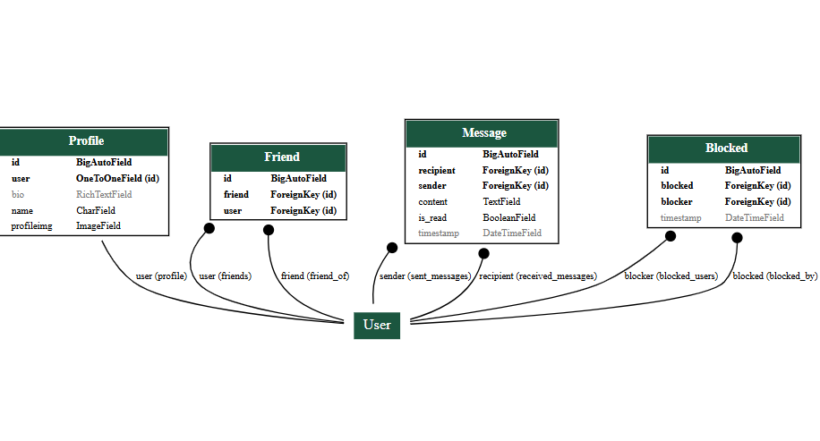
Eer(Enhanced entity-relationalship) diagram

Slide 7
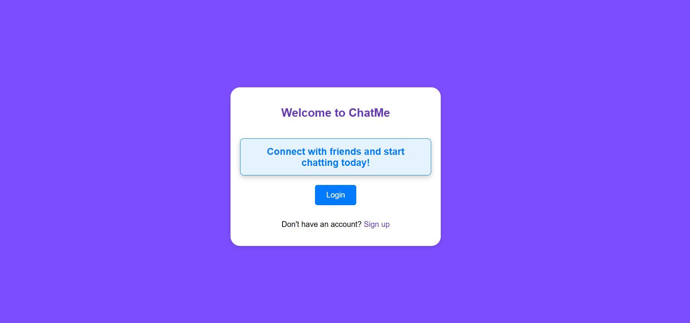
Welcome page

Slide 8
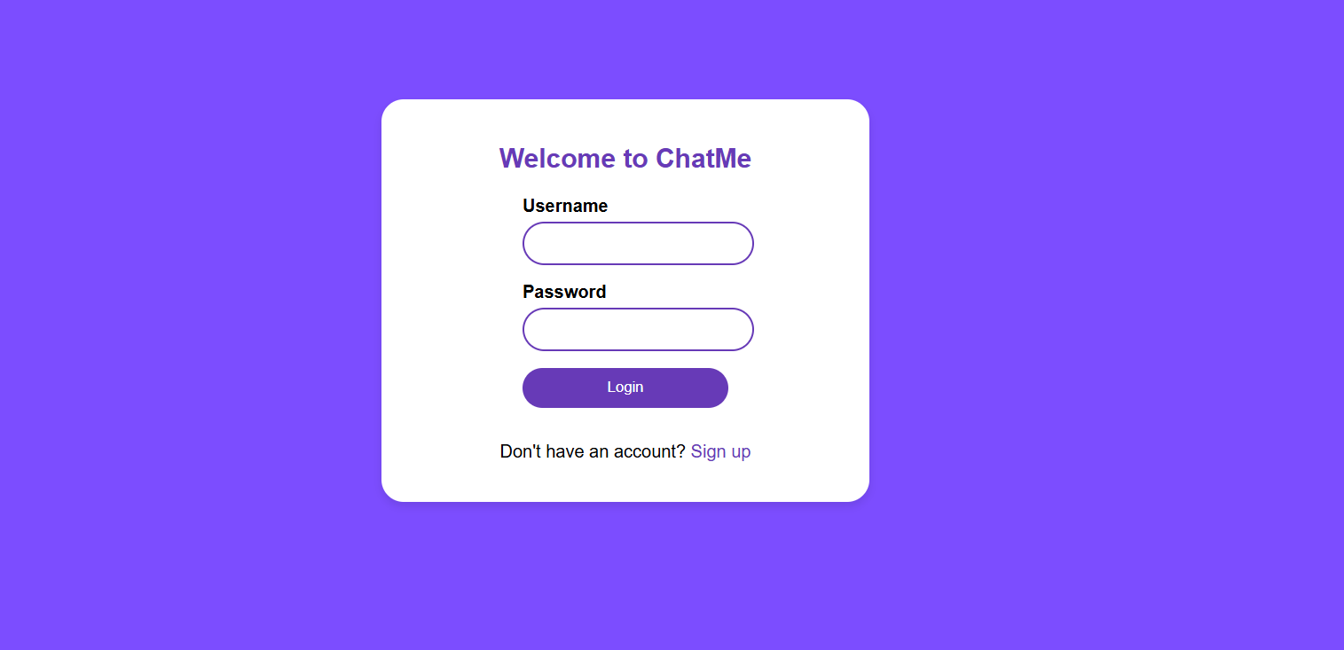
Login page

Slide 9
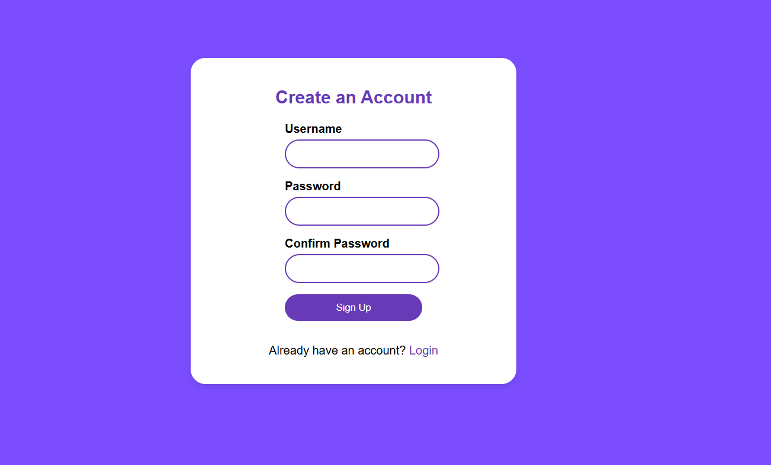
Signin page

Slide 10
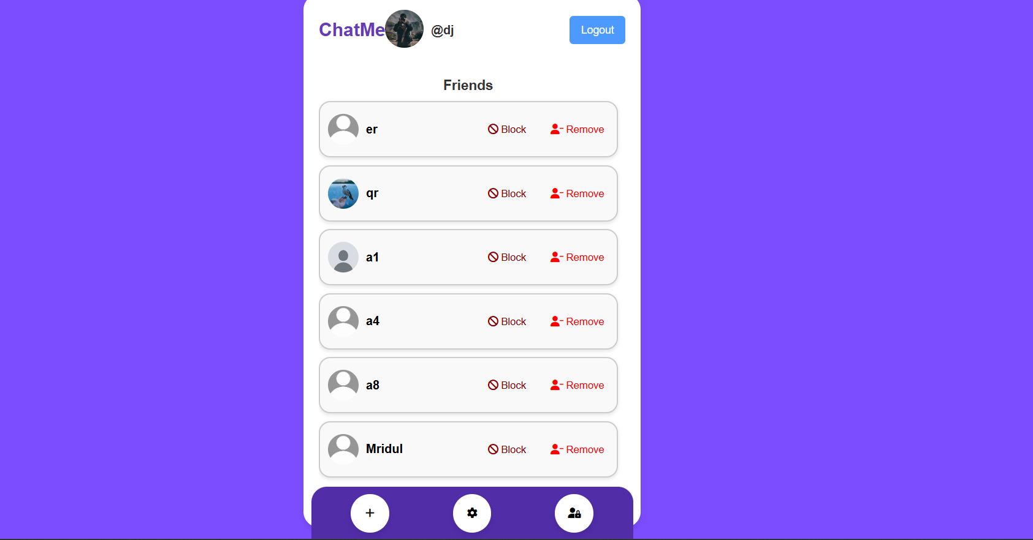
Home page
Settings button
Show Blocked Friend
Add Friend option

Slide 11
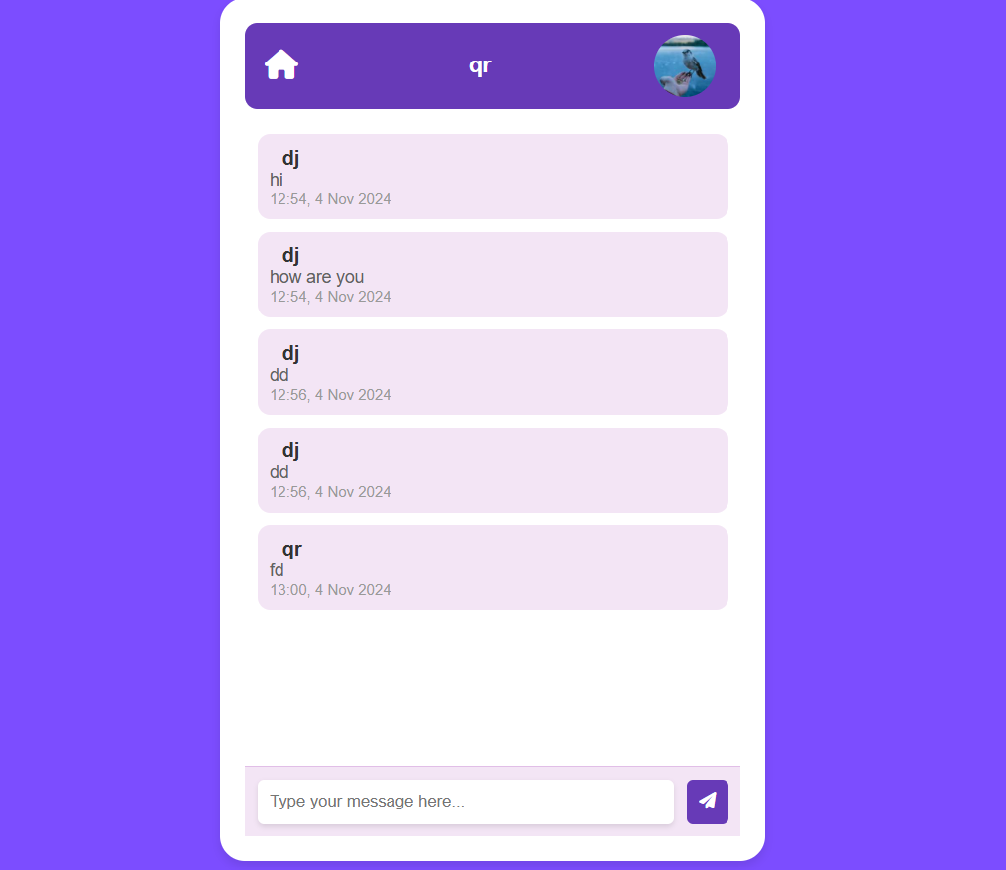
Messages page
View friend’s profile

Slide 12
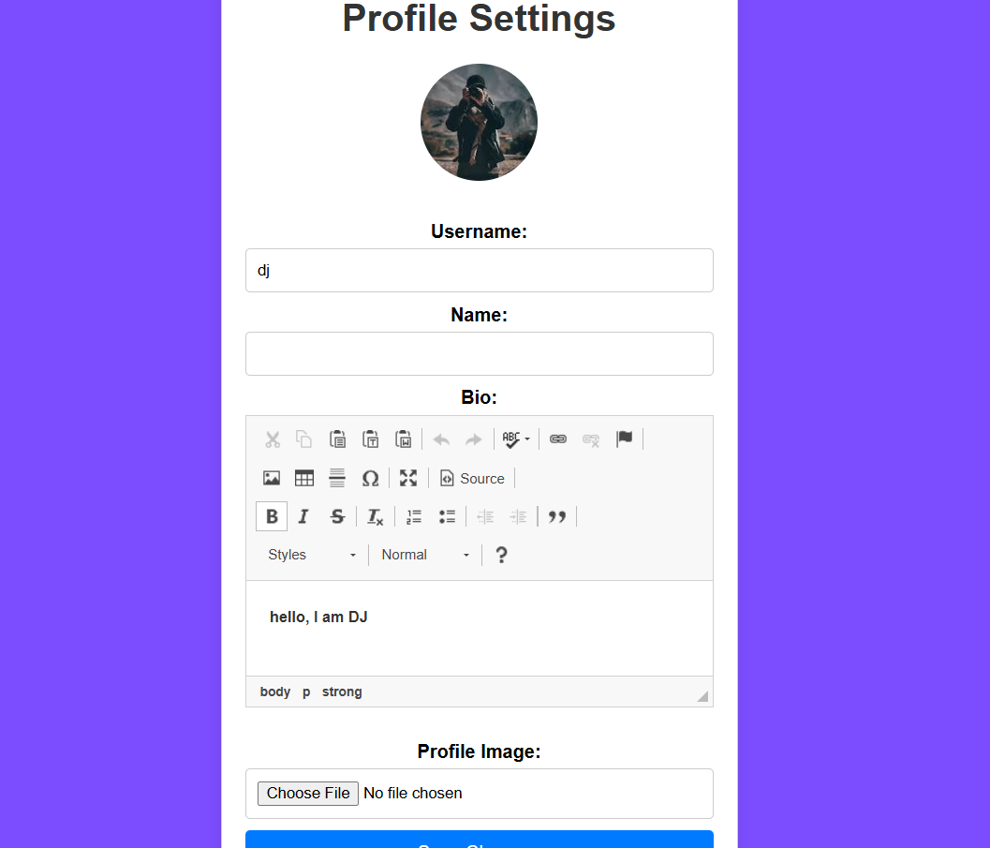
Profile settings

Slide 13
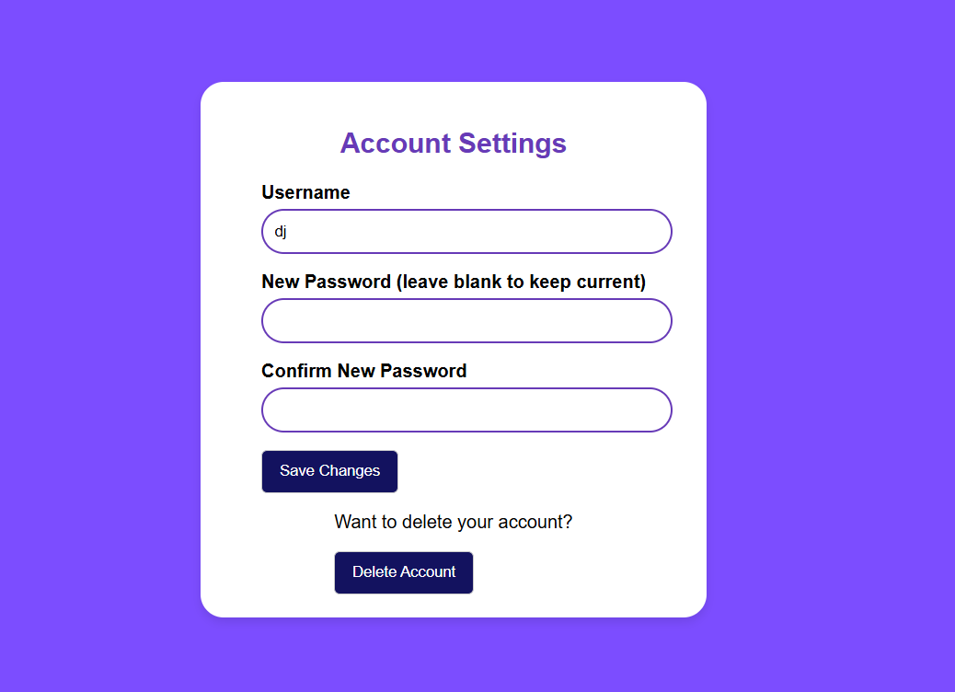
Account settings

Slide 14
Motivation
Enhancing Communication: The primary motivation is to create a platform that facilitates seamless communication among users, allowing them to connect and share ideas in real time
Real-World Application: Building a chat app provides an opportunity to apply theoretical knowledge in web development, focusing on user interactions, data management, and real-time functionalities.
Social Connectivity: Recognizing the importance of social connections in our lives, the motivation is to provide a tool that helps users maintain relationships, whether for personal or professional purposes.
User-Centric Design: The desire to create a user-friendly interface that prioritizes the user experience, making it easy for anyone to engage with the app, regardless of their technical skills.

Slide 15
THANK YOU
REFERENCES:->
HTML/CSS online tutorials for frontend
Dr. Amrita Chaturvedi lecture slides for MySQL
Django official documentation

